Slide 1
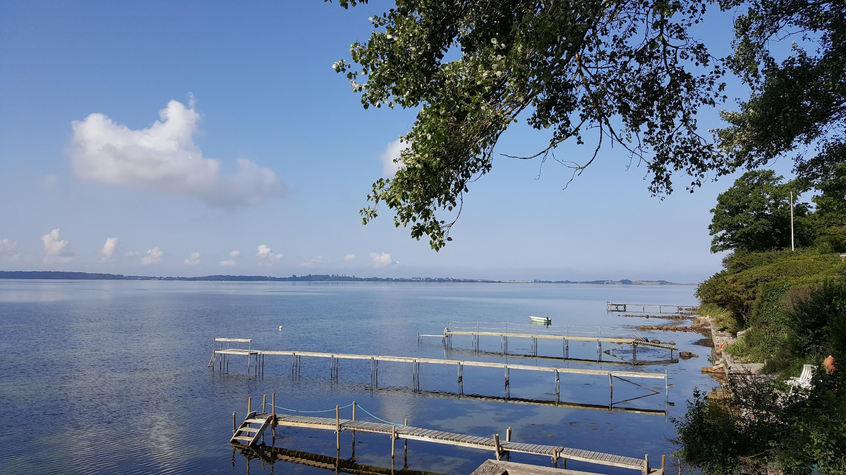
Forside
CRAFT and its applicability in Denmark
Professor Anette Søgaard Nielsen, MA, PhD
ansnielsen@health.sdu.dk

Slide 2
Our study
A cluster-randomised study, involving approx. one third of the public funded treatment institutions for AUD in Denmark
Treatment institutions were randomized to offer either Community Reinforcement and Family Training (CRAFT) as:
6 individual sessions + self-help material OR
6 sessions in open groups + self-help material OR
Self-help material
Qualitative sub-studies
A secondary analysis

Slide 3
We wished to test CRAFT:
In a real life-setting
In versions that would have a chance to become implemented, if it proved effective
With as few exclusion criteria as possible

Slide 4
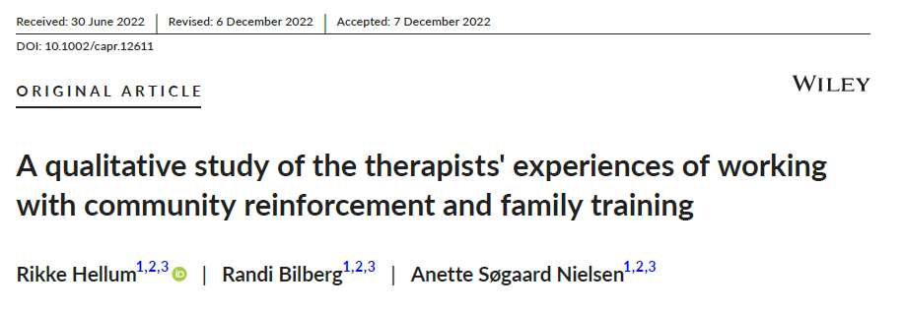
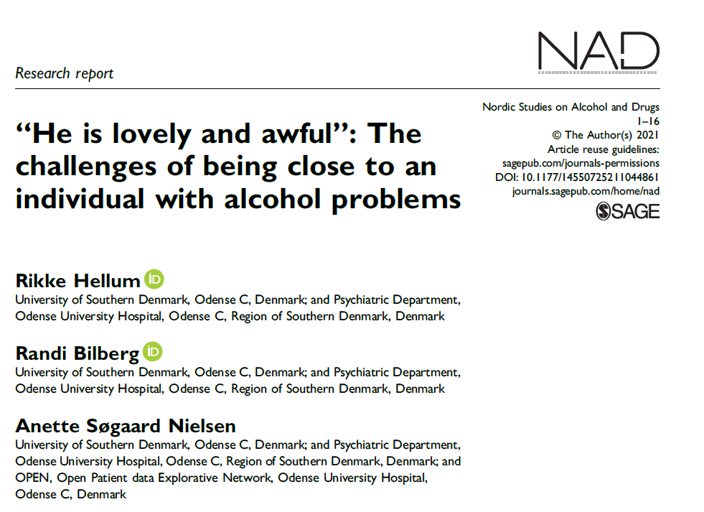
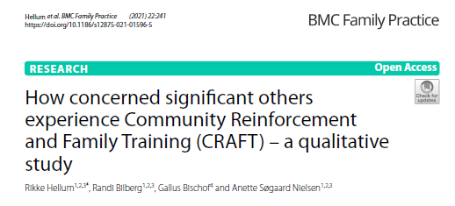
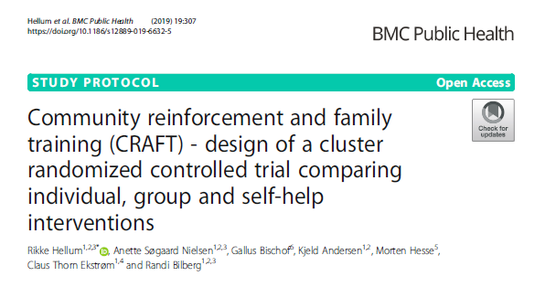
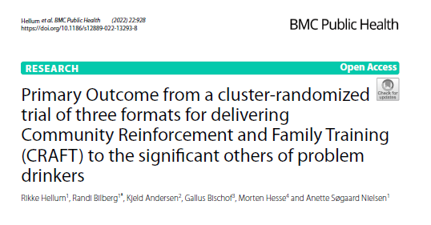
CRAFT

Slide 5
What did we learn?
There are many barriers for help-seeking, if you are a concerned significant other (CSO)
CRAFT is experienced as helpful by the CSOs
Face-to-face-CRAFT seems to be more effective than self-help
CRAFT is rather easily implemented, since it corresponds to the treatment offered to patients, suffering for AUD
It is manageable to offer CRAFT in open groups

Slide 6
What has an impact on the effect of CRAFT:
Hellum et al. BMC Public Health (2024) 24:213

Slide 7
What did we learn?
There are many barriers for help-seeking, if you are a concerned significant other (CSO)
CRAFT is rather easily implemented, since it corresponds to the treatment offered to patients, suffering for AUD
CRAFT is experienced as helpful by the CSOs
Face-to-face-CRAFT seems to be more effective than self-help
It is manageable to offer CRAFT in open groups
There seem to be wide limits for what kind of relation, the CSO has with the drinker, how much time the CSO must spend with the drinker and how much the CSO drinks him/herself for CRAFT to be helpful

Slide 8
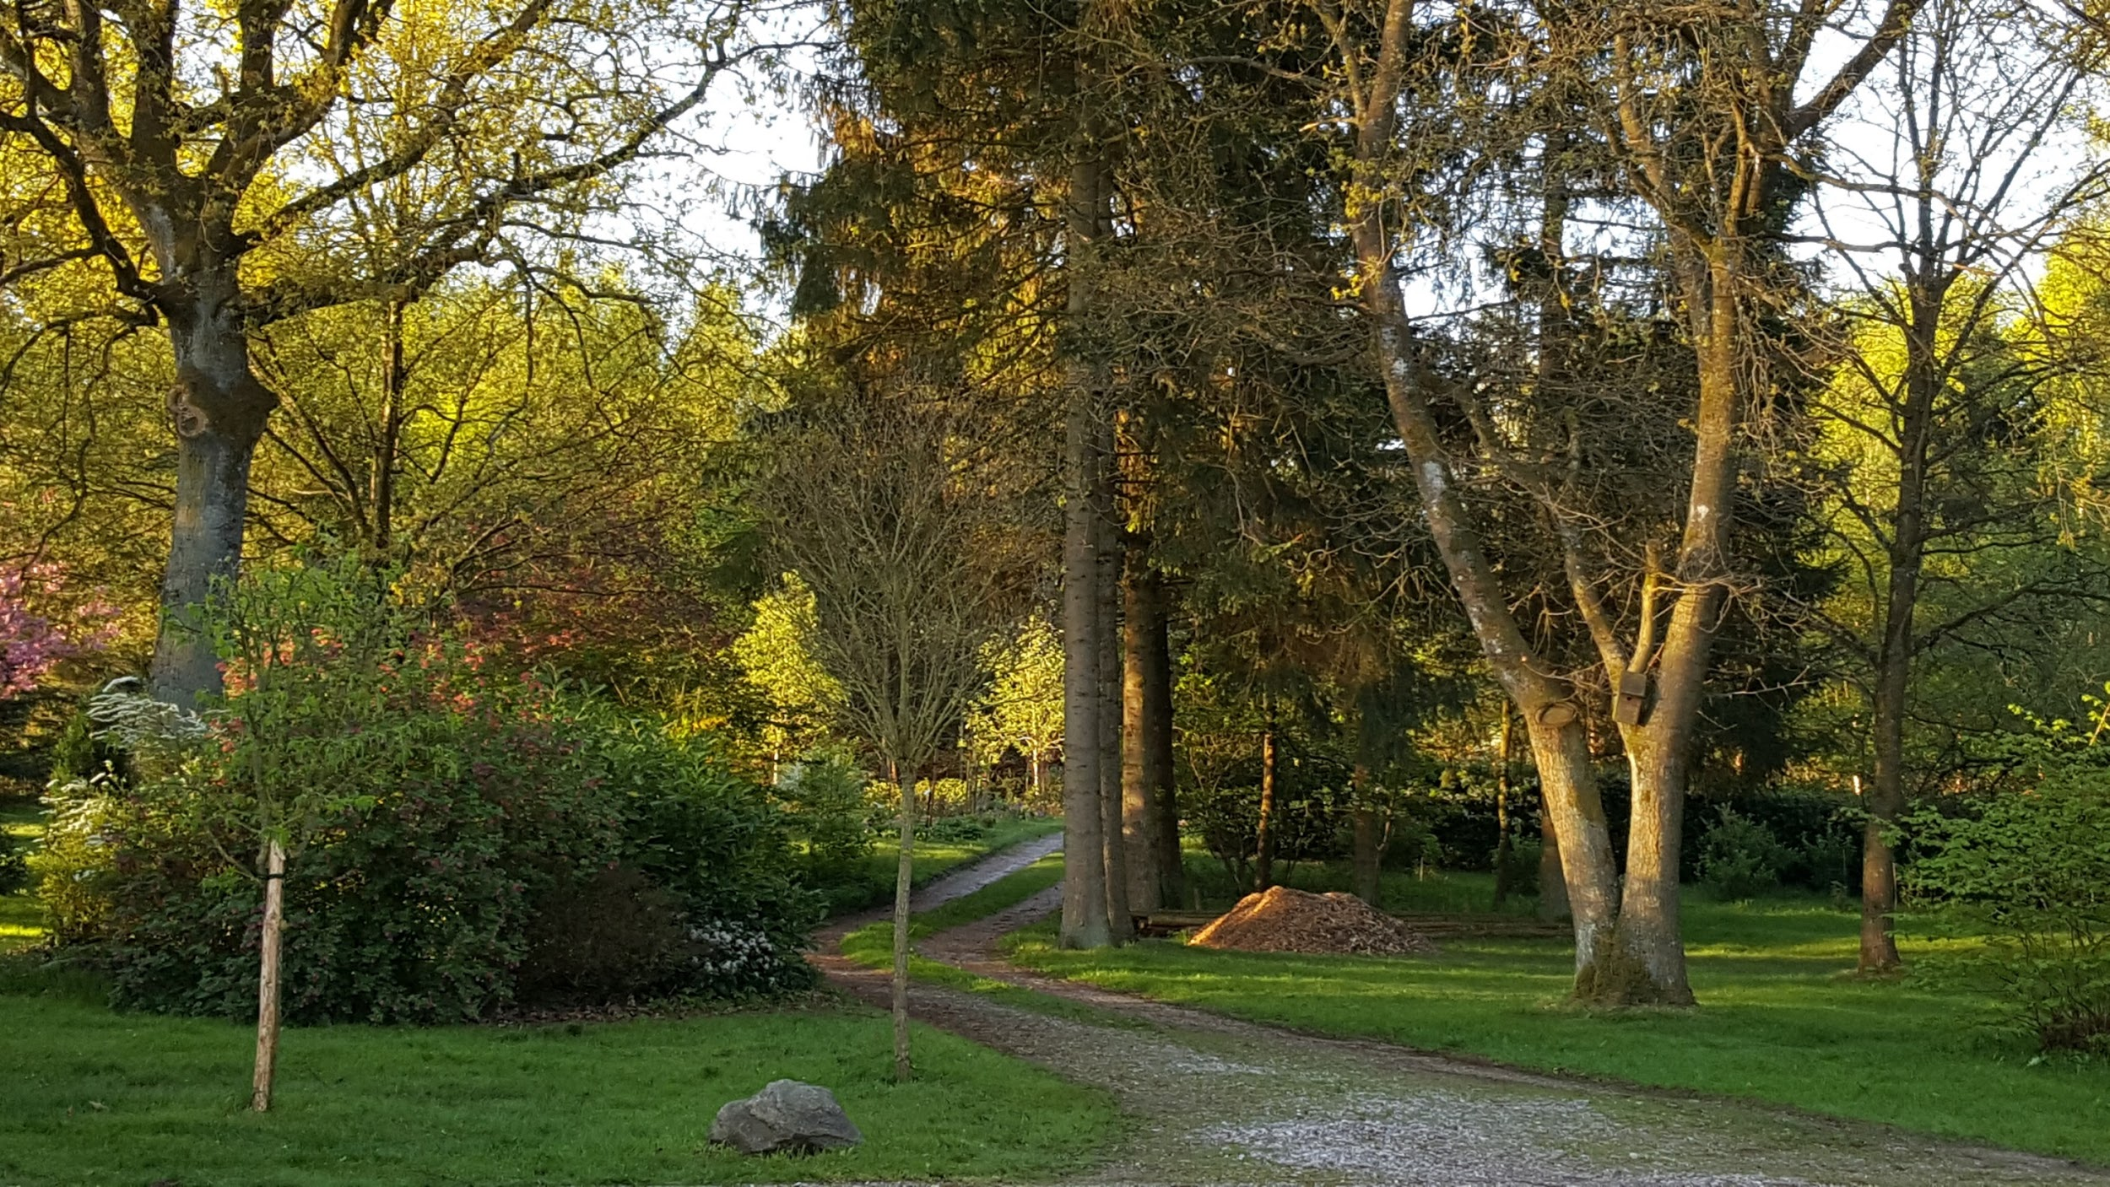
Thank you for listening..

